Slide 1

Group 4: Remote Backup Utility System
Group Members:
Akshat Singla
Debarati Pal
Lakshmi Swetha Mogadala
Rounak Garg
Tanishq Saproo

Slide 2

CONTENTS
INTRODUCTION
VARIETY OF BACKUP
DFD LEVEL 0
DFD LEVEL 1
FLOW DIAGRAM
PROGRAMMING LOGIC USED
PROGRAMS USED IN PROJECT
FUNCTIONS USED IN PROJECT
TOOLS USED IN TESTING
TESTING RESULT
IMPLEMENTATION OF PROJECT
FINAL RESULT

Slide 3
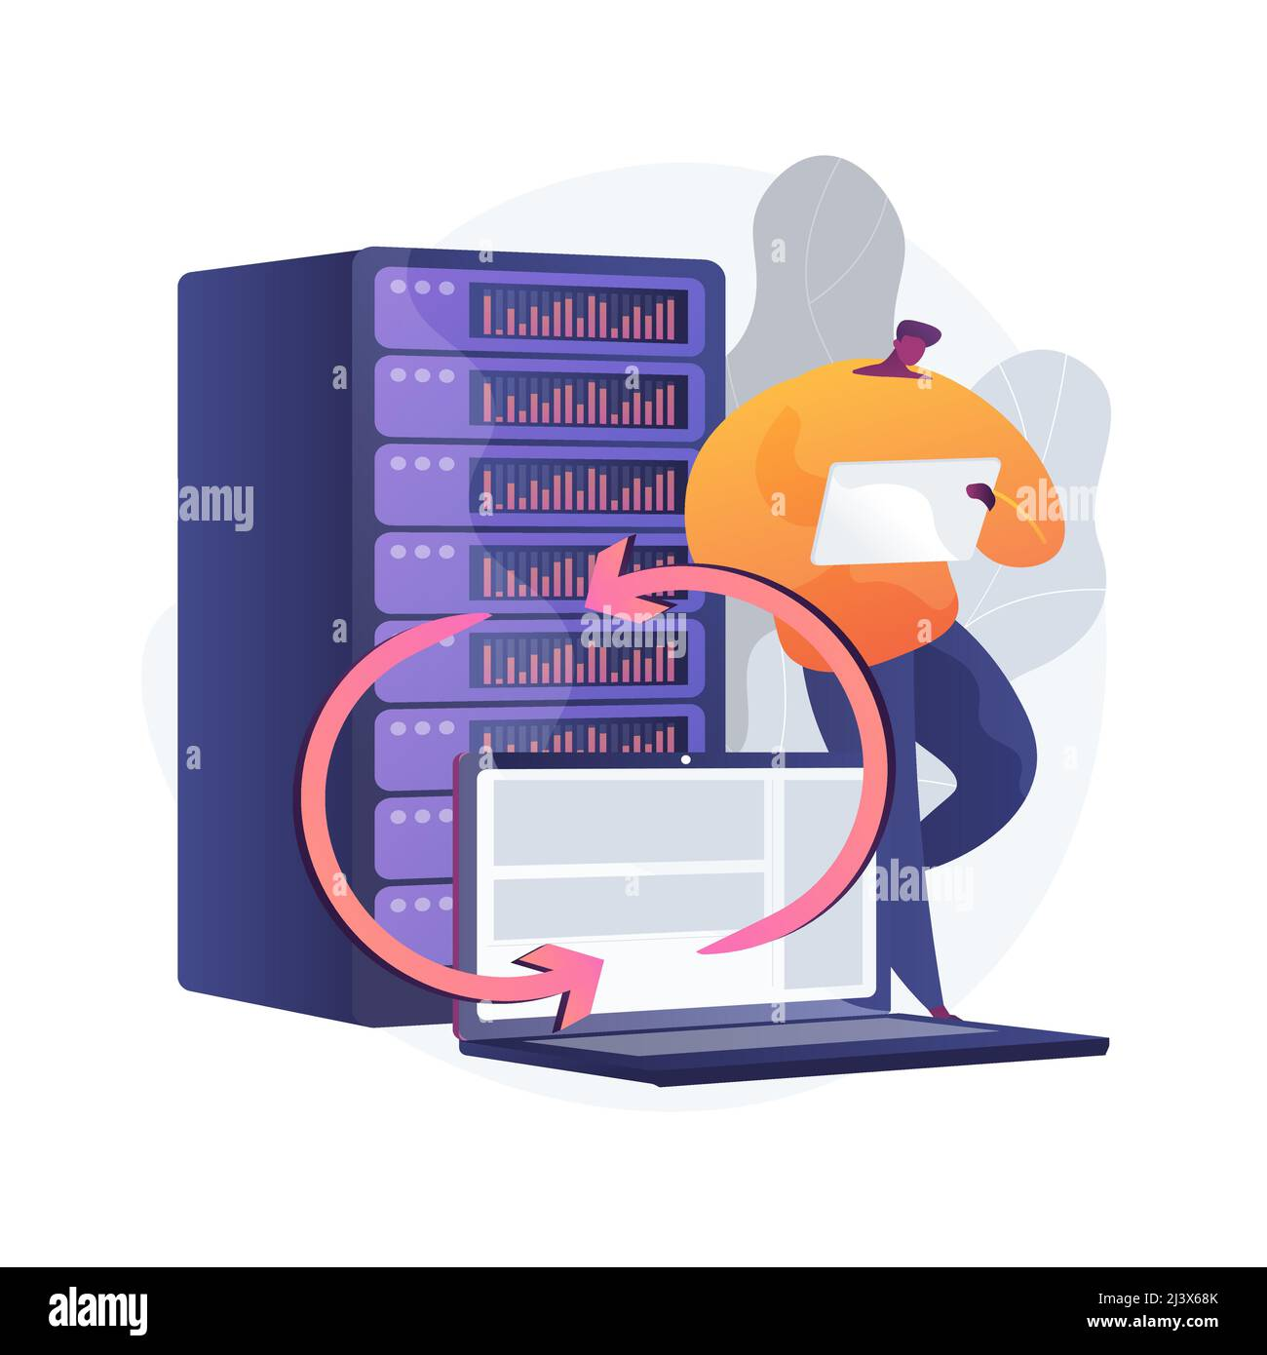
INTRODUCTION
Here we are making a client server backup application for backup the files which are present in Data directory
After the backup we putting all the data into Backup directory by the server
Files are giving from the client side and server making a backup.

Slide 4
VARIETY OF BACKUP IN PROJECT
FULL BACKUP
In our project We implement Four types of Backup
INCREMENT BACKUP
SCHEDULE BACKUP
JUST IN TIME BACKUP

Slide 5
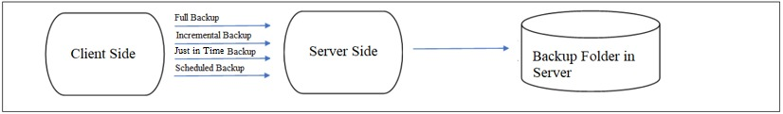
DFD LEVEL 0

Slide 6
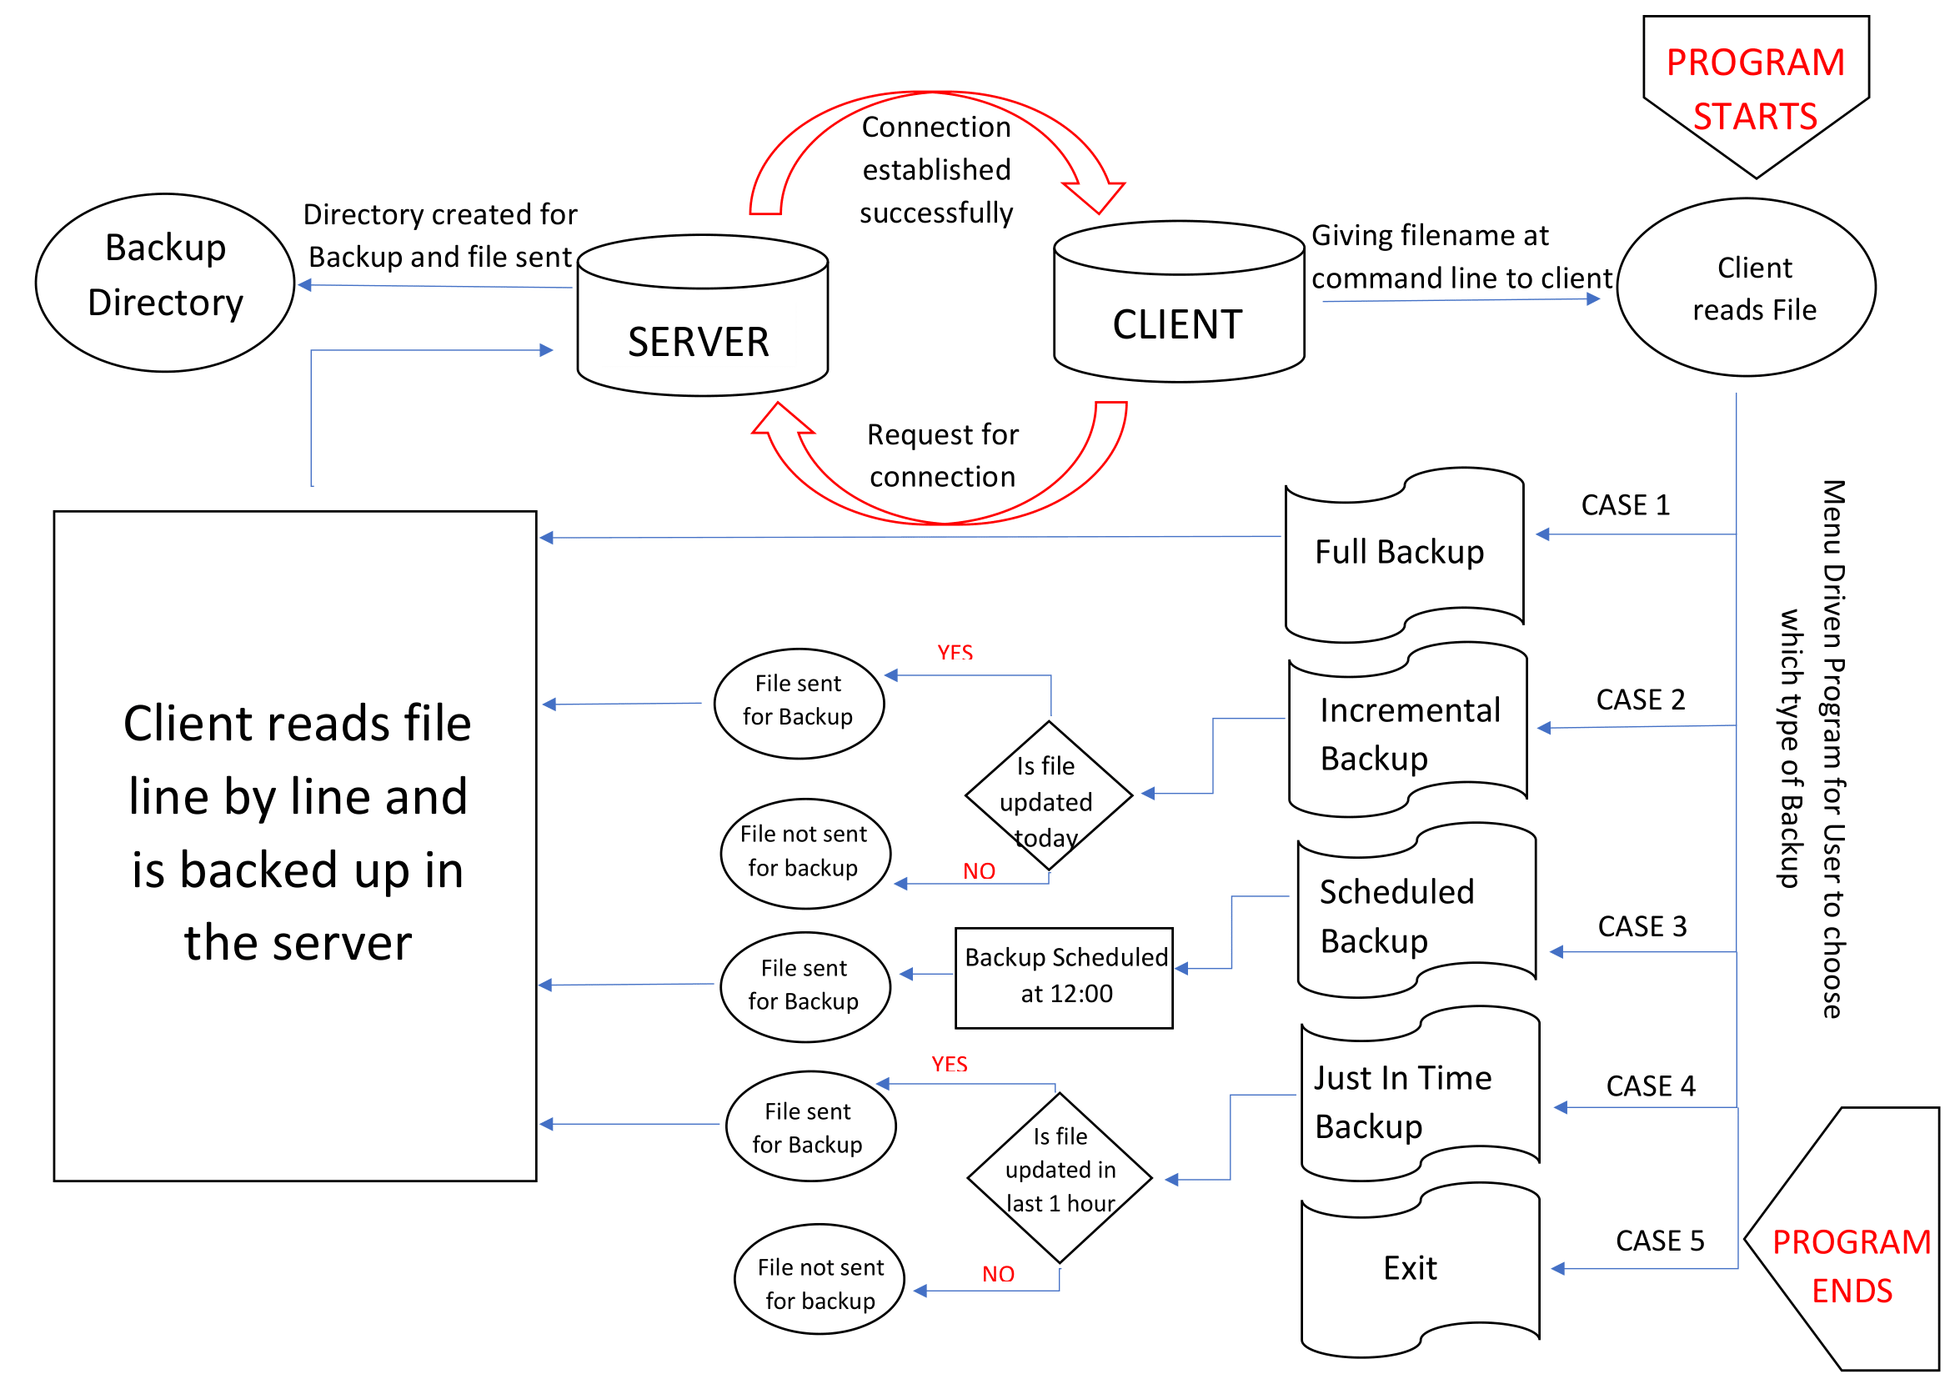
DFD LEVEL 1
DFD LEVEL 1

Slide 7
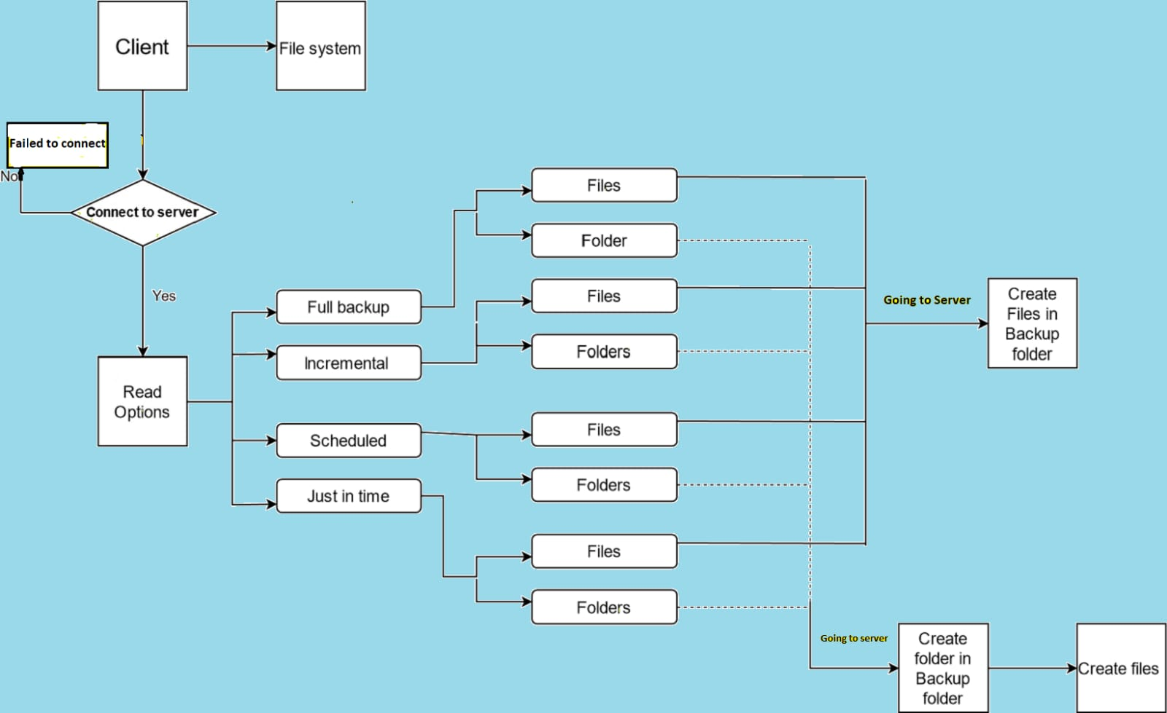
FLOW DIAGRAM

Slide 8
Programming Logics Used In Project
SOCKET PROGRAMMING
For making client side and server side and making the connection between both client and server
FILE HANDLING
To open the file from client side and reads the data and send to the server for backup

Slide 9
PROGRAMS USED IN THE PROJECT
CLIENT .C
Client reads the data from the file line by line and send to the server for backup
SERVER .C
Server reads the data
From the server and do backup by putting the data in the Backup Directory
Requesting For Connection
Connection Stablished

Slide 10
FUNCTIONS USED IN THE PROJECT
CLIENT.C
VOID FULL_BACKUP
Establish connection b/w server and client
SERVER.C
VOID INCREMENT_BACKUP
INT MAIN
VOID JUST_IN_TIME_BACKUP
VOID SCHEDULED_BACKUP

Slide 11
IMPLEMENTATION OF PROJECT
SERVER.C
CLIENT.C

Slide 12
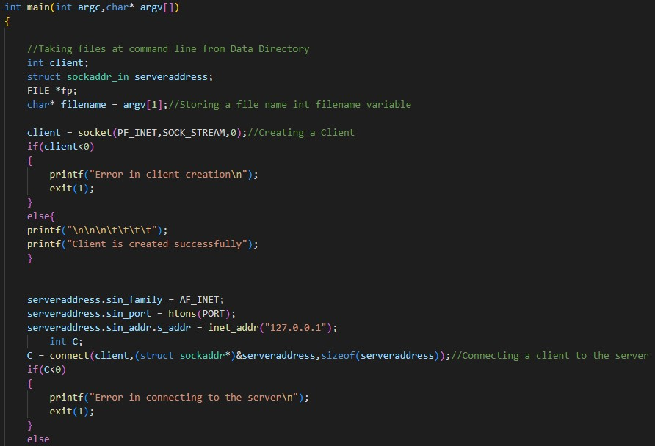
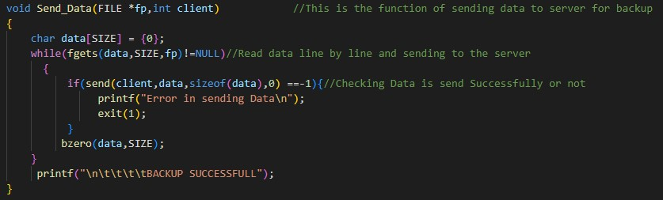
CODING IMPLEMENTATION ON CLIENT SIDE

Slide 13
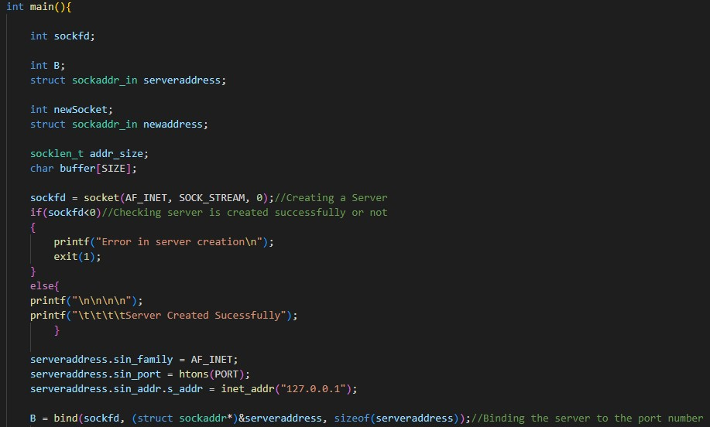
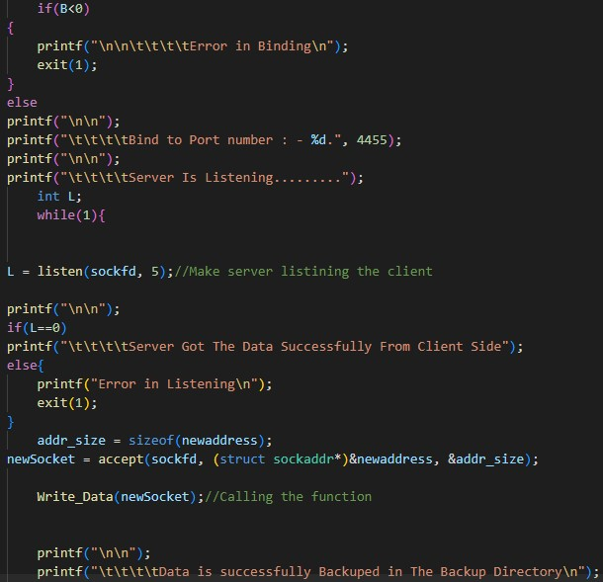
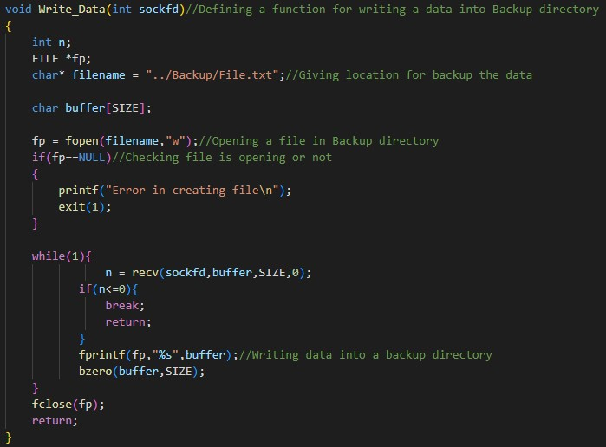
CODING IMPLEMENTATION ON SERVER SIDE

Slide 14
TOOLS USED IN TESTING
SPLINT
Splint is a tool for statically checking C programs for security vulnerabilities and common programming mistakes.It is run before compiling to check errors and coding mistake.
GCOV
Gcov is used how much percentage our code is executing and showining which line is executing in our code.

Slide 15
TOOLS USED IN TESTING
VALGRIND TOOL
It checks for memory leakage or not when we are allocating memory using Dynamic Memory Allocation,so we have to free memory in the last of the program
PROFILING TOOL(gprof)
gprof a performance analysis tool used to profile applications to determine where time is spent during program execution.

Slide 16
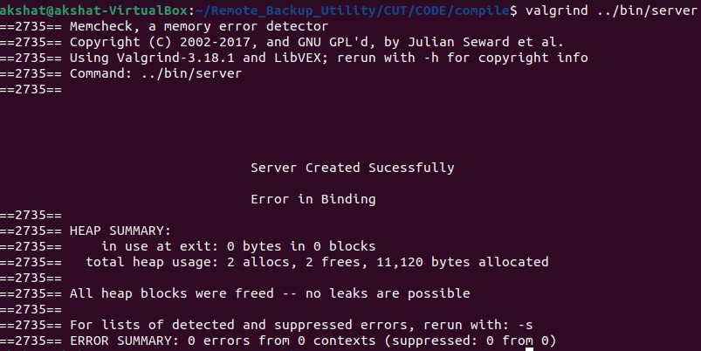
VALGRIND ON SERVER SIDE

Slide 17
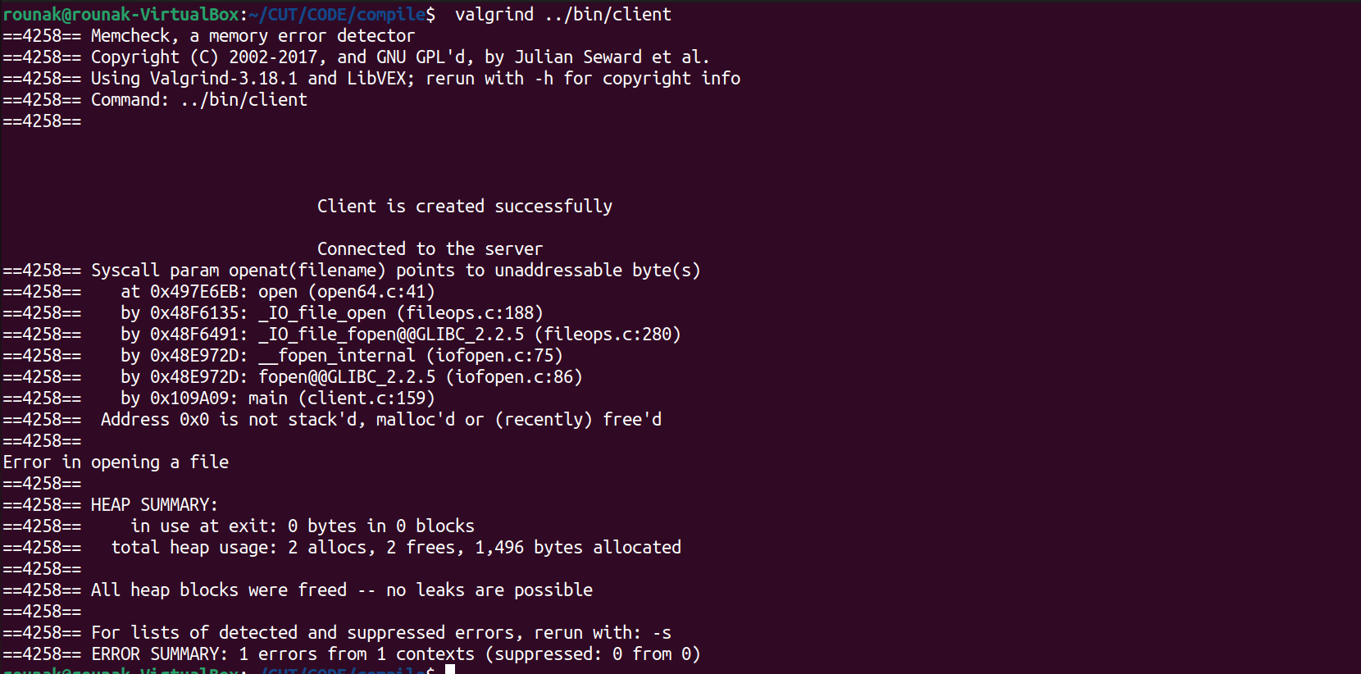
VALGRIND ON CLIENT SIDE

Slide 18
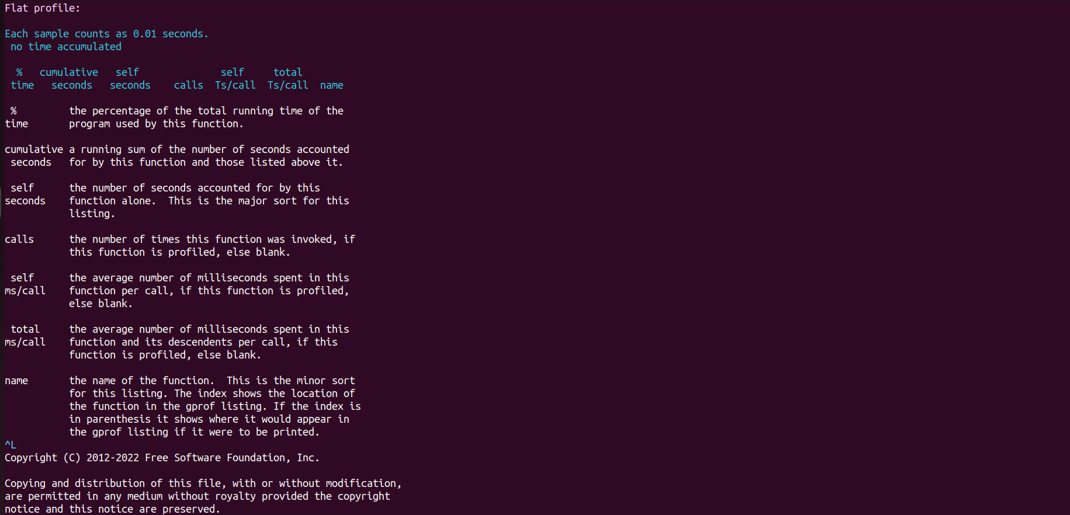
PROFILING ON SERVER SIDE

Slide 19

PROFILING ON CLIENT SIDE

Slide 20

SPLINT ON CLIENT SIDE

Slide 21

SPLINT ON SERVER SIDE

Slide 22
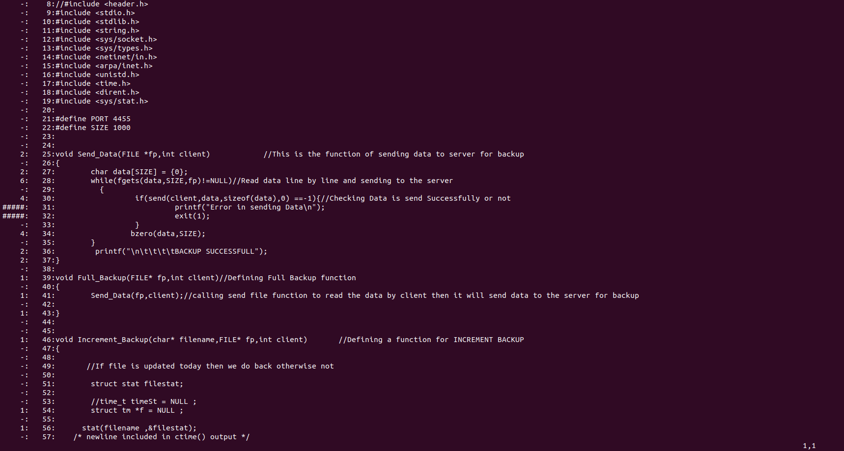
GCOV REPORT

Slide 23
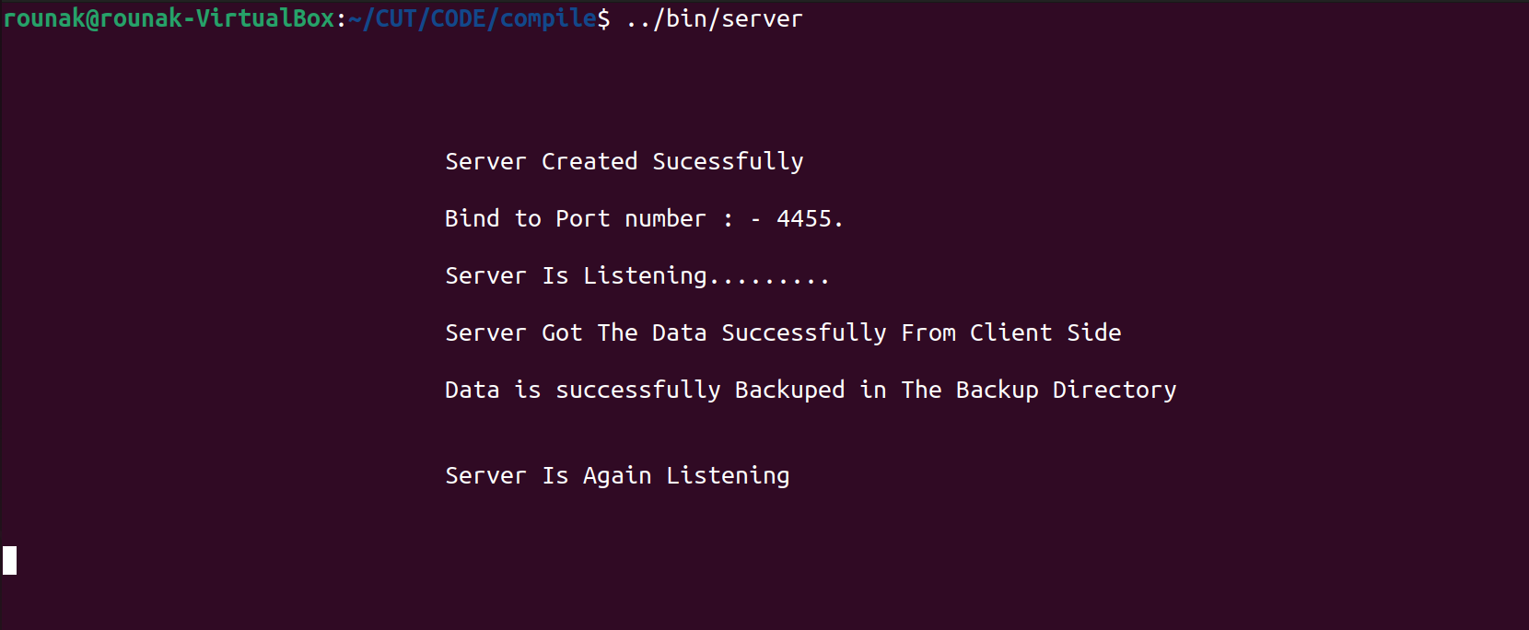
SERVER.C

Slide 24
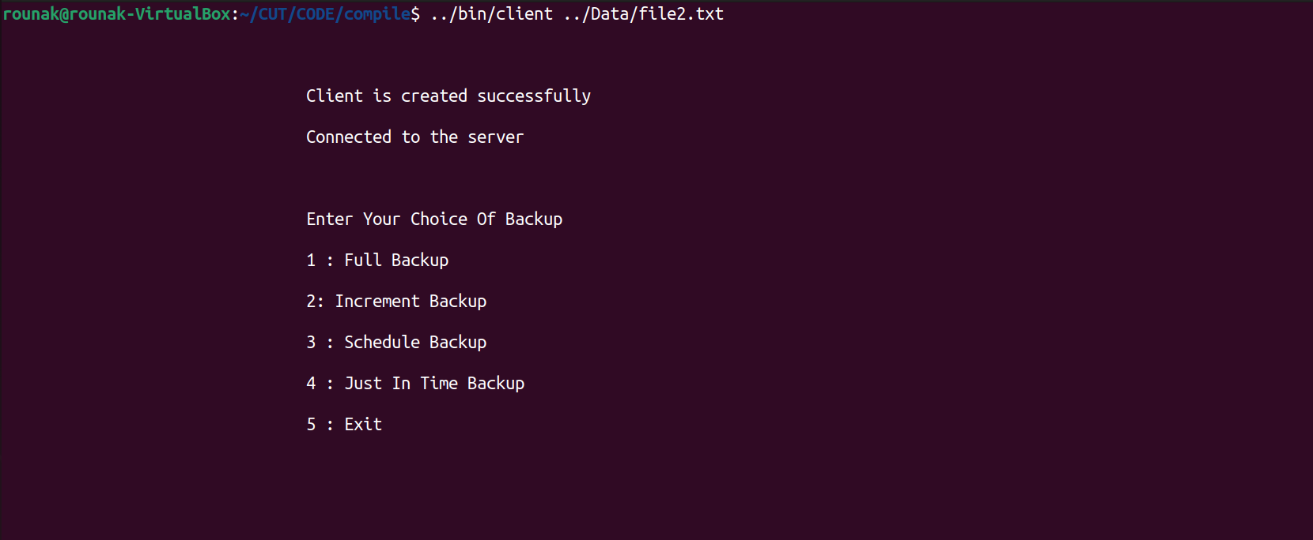
CLIENT.C

Slide 25
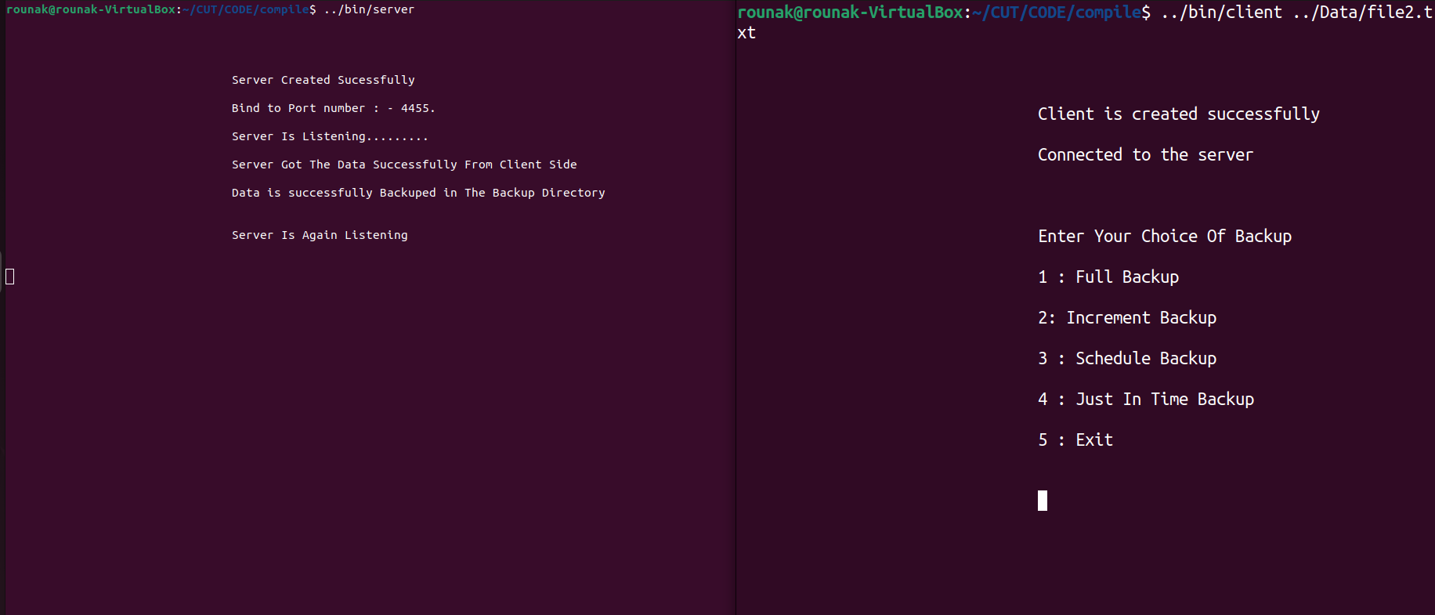
FINAL RESULT

Slide 26


